Slide 1
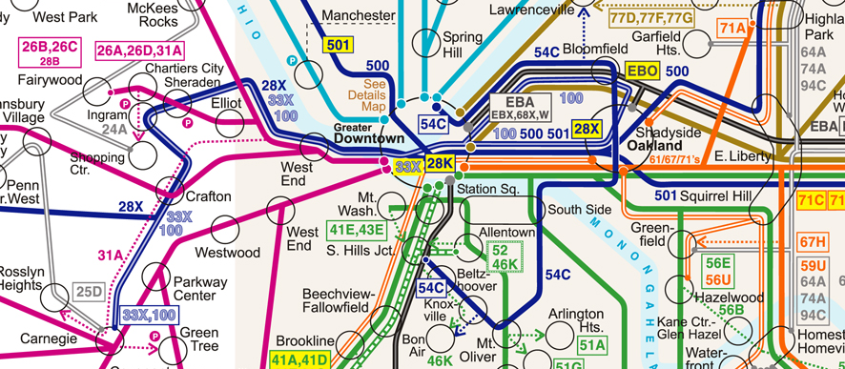


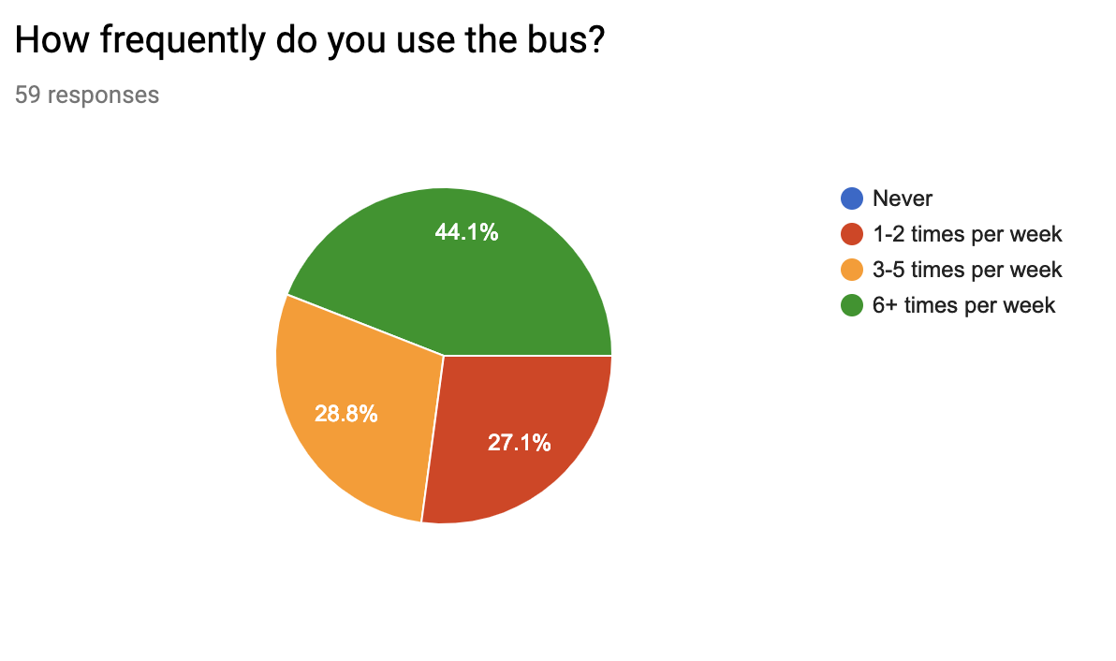


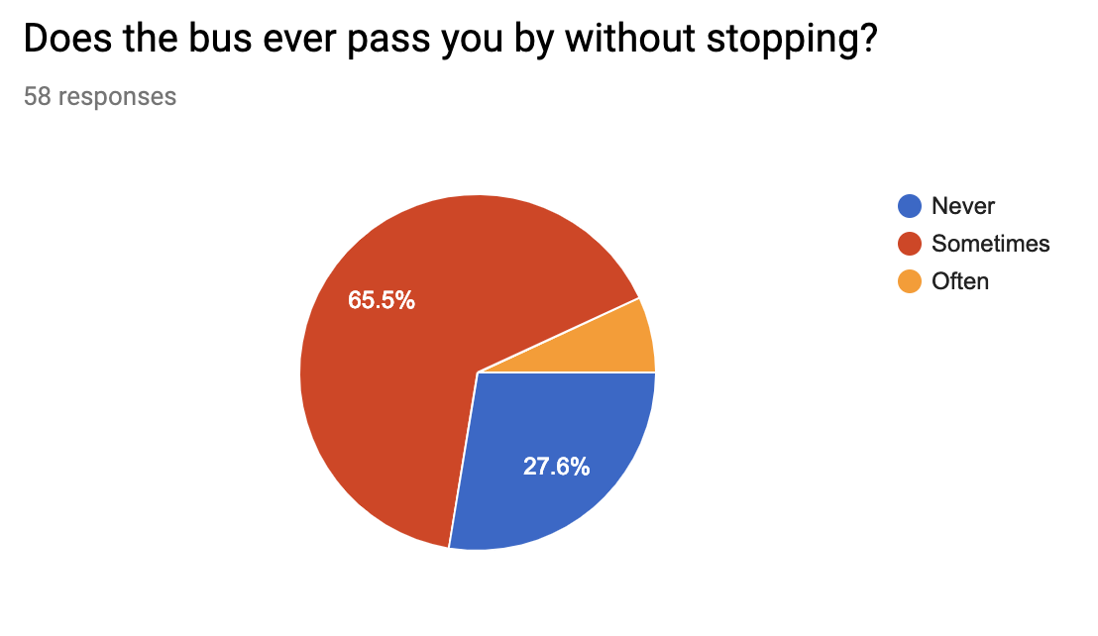
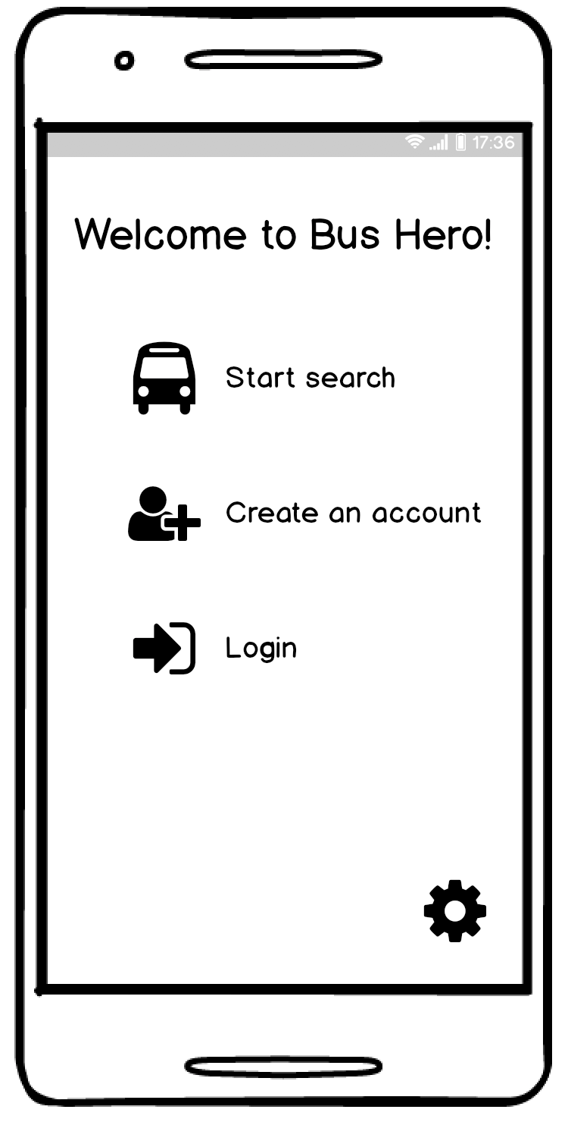
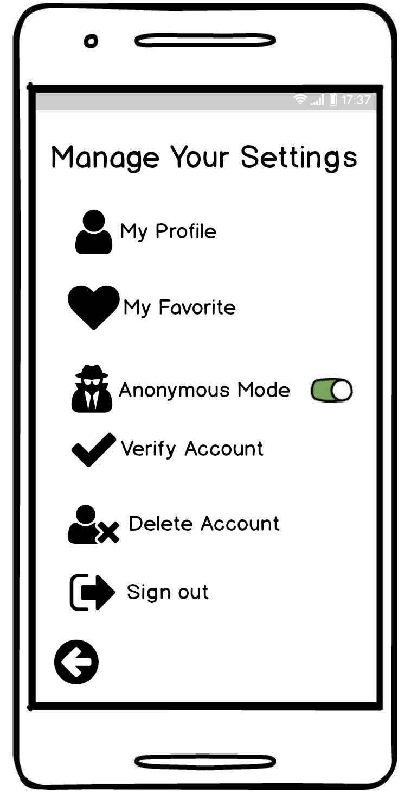
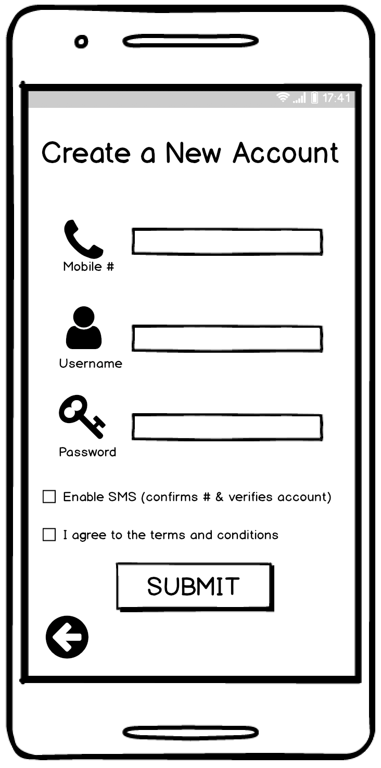
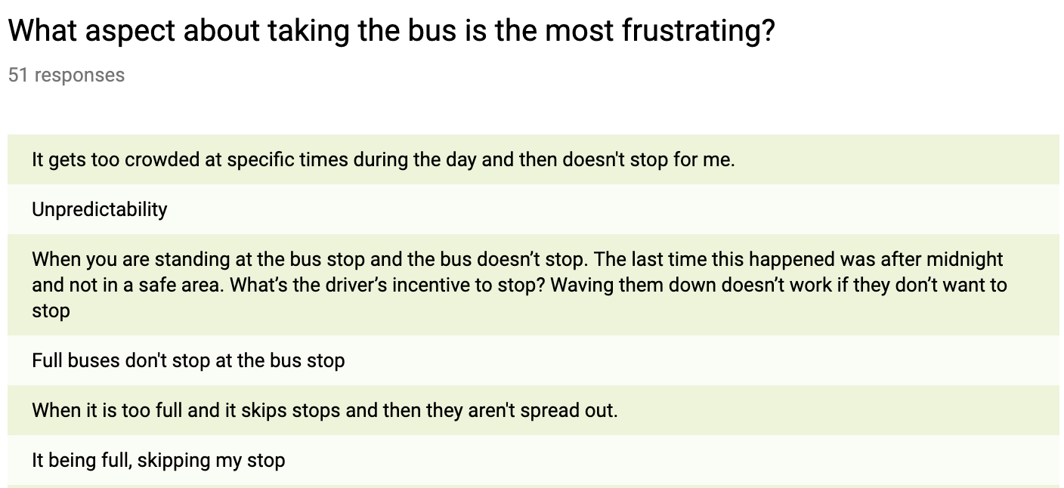
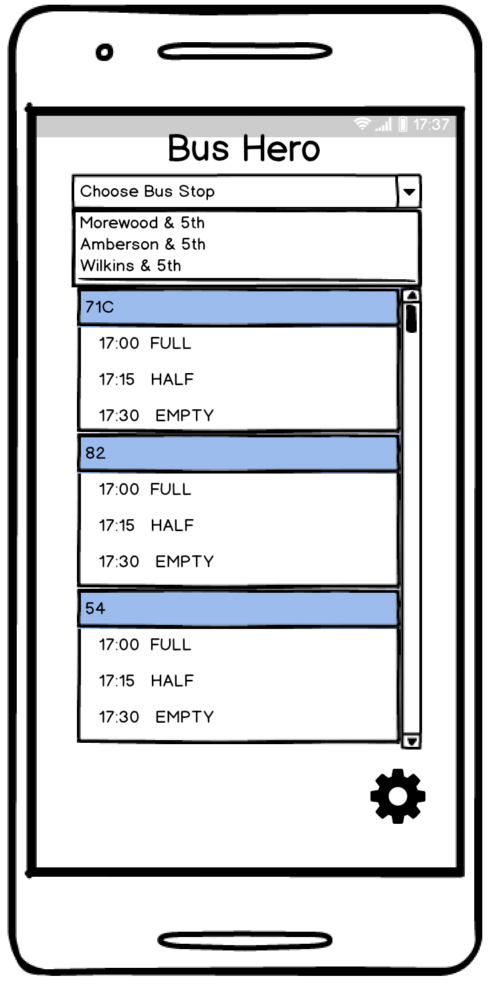
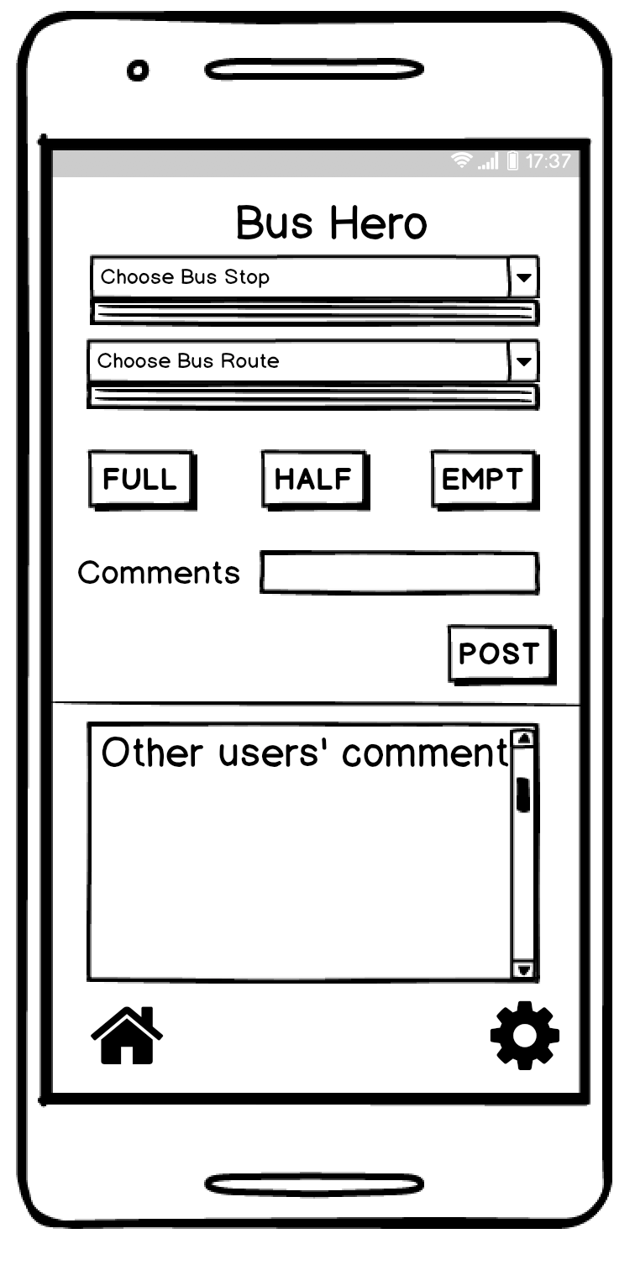
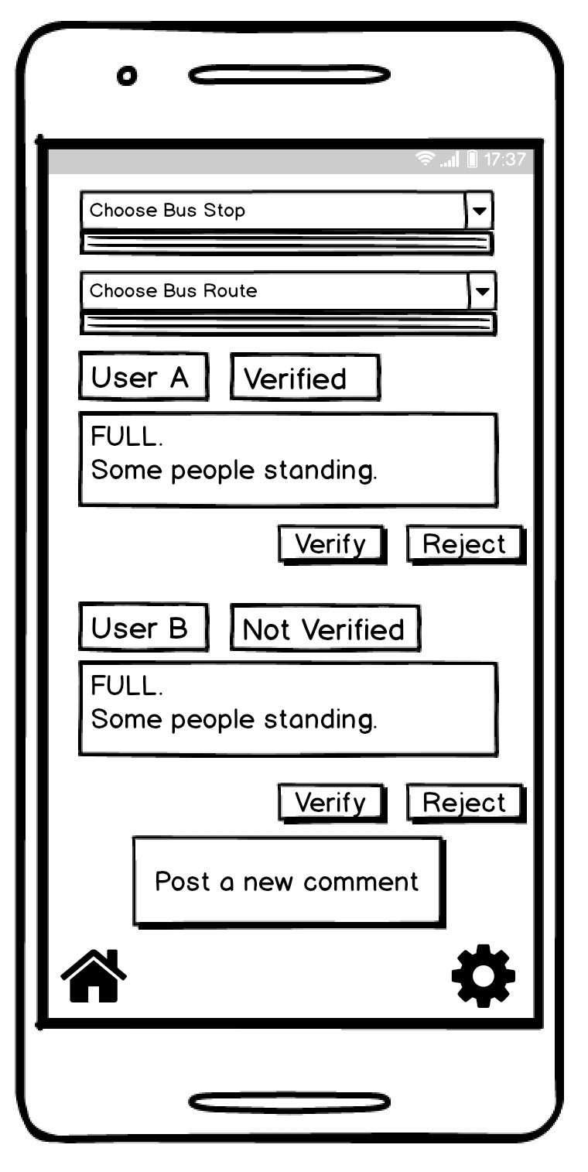





Bus Hero
Motivation
Spring 2019: 17-781 Mobile & IoT Computing Services
Yunqian Chen, Cong Liao, Jennifer Liu, Dan Messina
Riders
Better Bus Experience
Concept
User Scenarios
Bus Hero is a mobile transportation app utilizing the power of crowdsourcing to improve rider experience on the Pittsburgh bus system. With this app, users can share and report important updates, like if the approaching bus is at capacity, live traffic conditions, and community-suggested alternate routes to reduce the stress and difficulty of the commute.
Student
Employee
Name: Amanda
Age: 22
Takes bus to school 4 days per week and as no other means of transportation
The morning bus frequently arrives late, but she needs to get to school on time for an exam
Name: Jason
Age: 45
Takes the bus downtown 5 days per week to avoid parking
The buses fill too quickly during the evening rush, but needs to get home for dinner with his family
Business Model
Freemium Model:
Users will be able to download Bus Hero for free on iOS and Android
Additional $1 fee for users looking to access higher level of stats and information
Revenue generated from ads
Transportation and capacity data sold to third parties (e.x. The City of Pittsburgh)
User logs in or starts searching immediately
Access to favorite routes and choice to remain anonymous
Users verify their account with their mobile numbers
User Privacy
Architecture
The user’s name, location, and transportation history are sensitive information, so we implemented:
Users account authenticated with mobile number
Users have the choice to post under their username or remain anonymous
Users exact location remains private
All data is encrypted
Maps SDK
Directions API
GTFS Data Exchange
Users can see the capacity of upcoming buses at their stop
Comment on bus capacity, traffic, or other frustrations
Comments can be viewed and verified to avoid misleading info.

